Slide 1
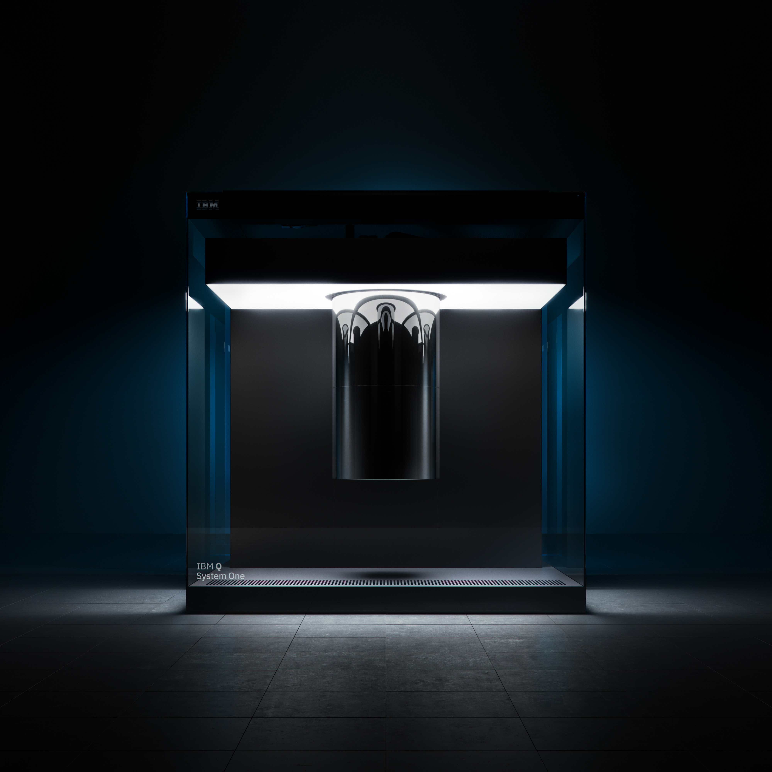

Quantum Teleportation with IBM Q — Joachim Schäfer IBM Q Ambassador

Slide 2
Theory Intro/Recap – Bell States
Bell States:
Relationship with Pauli Matrices:
Bit Flip
Sign Flip
Notes:
LaTeXiT Code Snippets:
Bell States:
\ket{\Phi^{\pm}}=\frac{1}{\sqrt{2}}\left(\ket{00}\pm\ket{11}\right)\\
\ket{\Psi^{\pm}}=\frac{1}{\sqrt{2}}\left(\ket{01}\pm\ket{10}\right)
Relationship of Pauli matrices and Bell States:
(I \otimes I)\ket{\Phi^{+}} = \ket{\Phi^{+}}\\
(I \otimes Z)\ket{\Phi^{+}} = \ket{\Phi^{-}}\\
(I \otimes X)\ket{\Phi^{+}} = \ket{\Psi^{+}}\\
(I \otimes XZ)\ket{\Phi^{+}} = \ket{\Psi^{-}}
Pauli X and Z:
X = \begin{pmatrix}
0 & 1\\
1 & 0
\end{pmatrix},\quad
Z = \begin{pmatrix}
1 & 0\\
0 & -1
\end{pmatrix}

Slide 3
Theory Intro/Recap – Quantum Teleportation
Alice’s State to be teleported:
Total initial 3-Qubit state:
Alice
Alice & Bob
share Bell state
Notes:
Theory of Quantum Teleportation using a Quantum Circuit is well explained in “Quantum Computation” & “Quantum Information” by Michael A. Nielsen & Isaac L. Chuang
Alice’s state to be teleported:
\ket{\psi} = \alpha\ket{0} + \beta\ket{1}
Alice’s & Bob’s complete three Qubit state:
\ket{\psi}\ket{\Phi^{+}} = \frac{1}{\sqrt{2}}(\alpha\ket{0}+\beta\ket{1})(\ket{00}+\ket{11})
next lines
\ket{\psi}\ket{\Phi^{+}} & = \frac{1}{\sqrt{2}}\left(\alpha\underbrace{\ket{00}}_{=\frac{\ket{\Phi^{+}}+\ket{\Phi^{-}}}{\sqrt{2}}}\ket{0} + \alpha\underbrace{\ket{01}}_{=\frac{\ket{\Psi^{+}}+\ket{\Psi^{-}}}{\sqrt{2}}}\ket{1} + \beta\underbrace{\ket{10}}_{=\frac{\ket{\Psi^{+}}-\ket{\Psi^{-}}}{\sqrt{2}}}\ket{0} + \beta\underbrace{\ket{11}}_{=\frac{\ket{\Phi^{+}}-\ket{\Phi^{-}}}{\sqrt{2}}}\ket{1}\right)\\
& =\frac{1}{2}\left(\ket{\Phi^{+}}\underbrace{(\alpha\ket{0} + \beta\ket{1})}_{=\ket{\psi}}+\ket{\Phi^{-}}\underbrace{(\alpha\ket{0} - \beta\ket{1})}_{=Z\ket{\psi}}+\ket{\Phi^{-}}\underbrace{(\alpha\ket{1} + \beta\ket{0})}_{=X\ket{\psi}}+\ket{\Phi^{-}}\underbrace{(\alpha\ket{1} - \beta\ket{0})}_{=XZ\ket{\psi}}\right)

Slide 4
Theory Intro/Recap – Quantum Teleportation
Alice’s State to be teleported:
…need to determine Bell state & apply correct pauli matrices to recover
Notes:
Theory of Quantum Teleportation using a Quantum Circuit is well explained in “Quantum Computation” & “Quantum Information” by Michael A. Nielsen & Isaac L. Chuang
Alice’s state to be teleported:
\ket{\psi} = \alpha\ket{0} + \beta\ket{1}
Alice’s & Bob’s complete three Qubit state:
\ket{\psi}\ket{\Phi^{+}} = \frac{1}{\sqrt{2}}(\alpha\ket{0}+\beta\ket{1})(\ket{00}+\ket{11})
next lines
\ket{\psi}\ket{\Phi^{+}} & = \frac{1}{\sqrt{2}}\left(\alpha\underbrace{\ket{00}}_{=\frac{\ket{\Phi^{+}}+\ket{\Phi^{-}}}{\sqrt{2}}}\ket{0} + \alpha\underbrace{\ket{01}}_{=\frac{\ket{\Psi^{+}}+\ket{\Psi^{-}}}{\sqrt{2}}}\ket{1} + \beta\underbrace{\ket{10}}_{=\frac{\ket{\Psi^{+}}-\ket{\Psi^{-}}}{\sqrt{2}}}\ket{0} + \beta\underbrace{\ket{11}}_{=\frac{\ket{\Phi^{+}}-\ket{\Phi^{-}}}{\sqrt{2}}}\ket{1}\right)\\
& =\frac{1}{2}\left(\ket{\Phi^{+}}\underbrace{(\alpha\ket{0} + \beta\ket{1})}_{=\ket{\psi}}+\ket{\Phi^{-}}\underbrace{(\alpha\ket{0} - \beta\ket{1})}_{=Z\ket{\psi}}+\ket{\Phi^{-}}\underbrace{(\alpha\ket{1} + \beta\ket{0})}_{=X\ket{\psi}}+\ket{\Phi^{-}}\underbrace{(\alpha\ket{1} - \beta\ket{0})}_{=XZ\ket{\psi}}\right)\\
& = \frac{1}{2}\left(\ket{\Phi^{+}}\ket{\psi} + \ket{\Phi^{-}}Z\ket{\psi} + \ket{\Psi^{+}}X\ket{\psi} + \ket{\Psi^{-}}XZ\ket{\psi}\right)

Slide 5
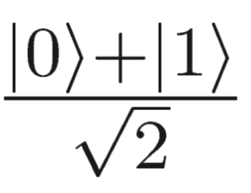
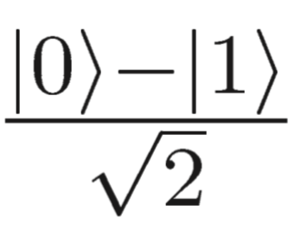
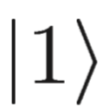
Exercise: Build Quantum Teleportation Circuit
Optional: Test one-qubit (e.g. X, H) and two-qubit gate (CNOT) in custom topology (one/two qubits) – use 1000 shots
10min: Implement Bell State:
15min: Implement Bell Measurement (i.e. how to determine each of the 4 Bell states?) + build 3 qubit circuit
10min: Implement Controlled-Z gate (controlled sign flip)
25min: Combine above elements to teleport a qubit from “Alice” to “Bob” (3-qubit circuit). Test teleportation of following states:
a)
b)
c)
Notes:
Bell state:
\ket{\Phi^{+}} = \frac{1}{\sqrt{2}}(\ket{00}+\ket{11})

Slide 6
10min: Implement Bell State

Slide 7
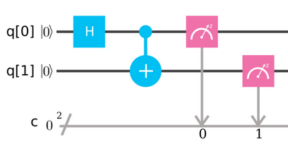
Bell State

Slide 8
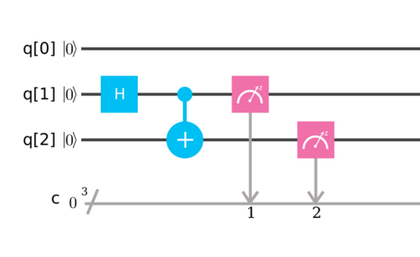
Bell State (in 3 qubit circuit)
Inverse ordering

Slide 9
15min: Implement Bell Measurement How to distinguish between 4 Bell States? + build 3 qubit circuit

Slide 10
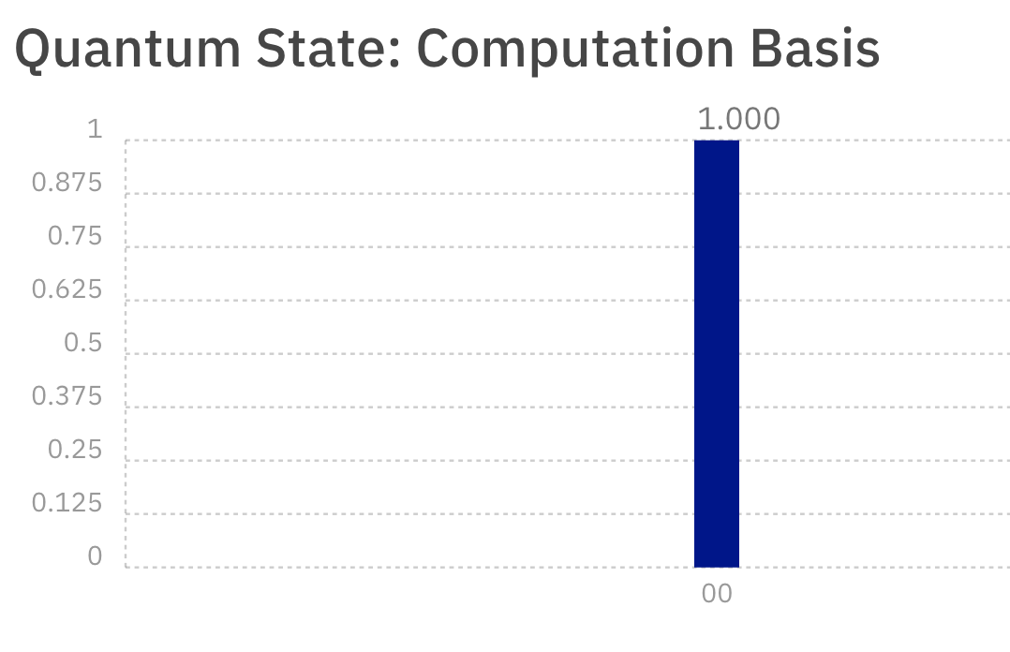
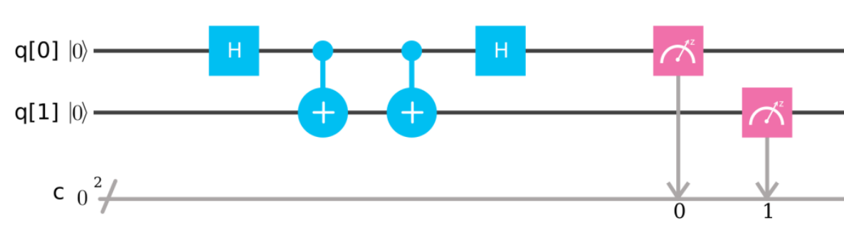
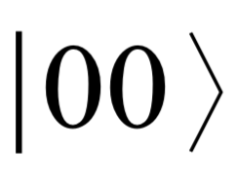
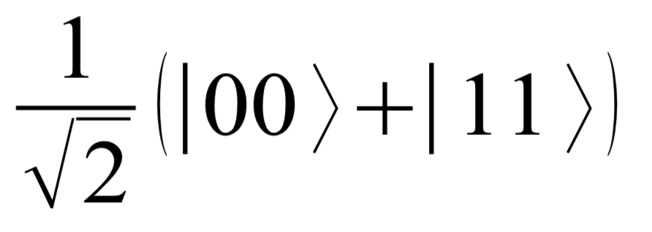
Bell Measurement
Notes:
Bell state:
\frac{1}{\sqrt{2}}(\ket{00}+\ket{11})

Slide 11
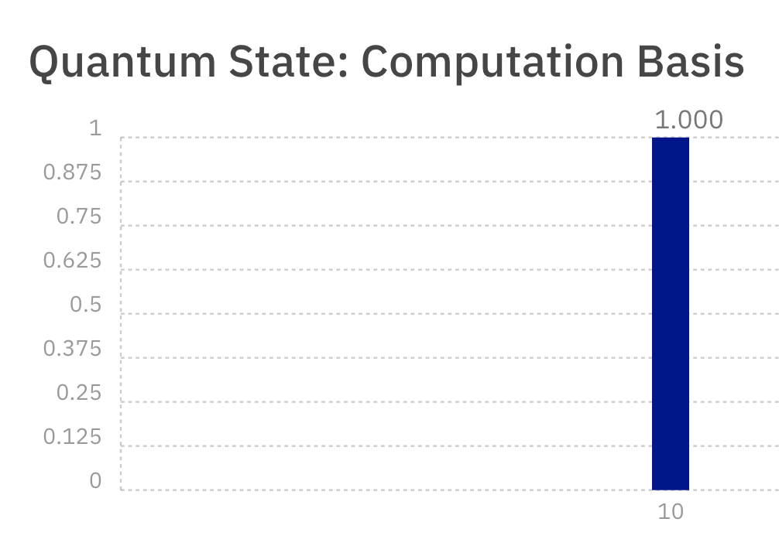
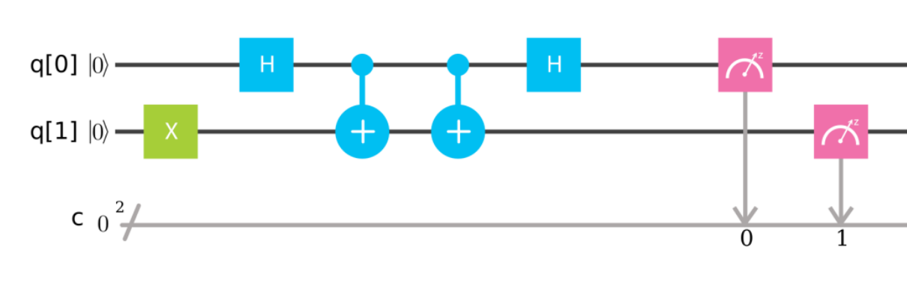
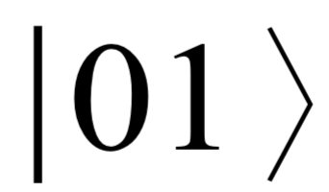
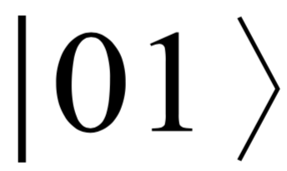
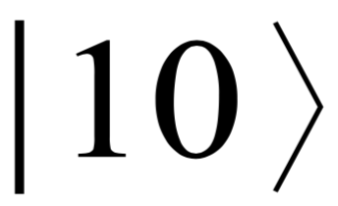
Bell Measurement
Corresponds to |01>
Notes:
Bell state:
\ket{\Psi^{+}}=\frac{1}{\sqrt{2}}(\ket{01}+\ket{10})

Slide 12
Bell Measurement
Corresponds to |01>
= Gate to change to Bell basis
Controlled-Not

Slide 13
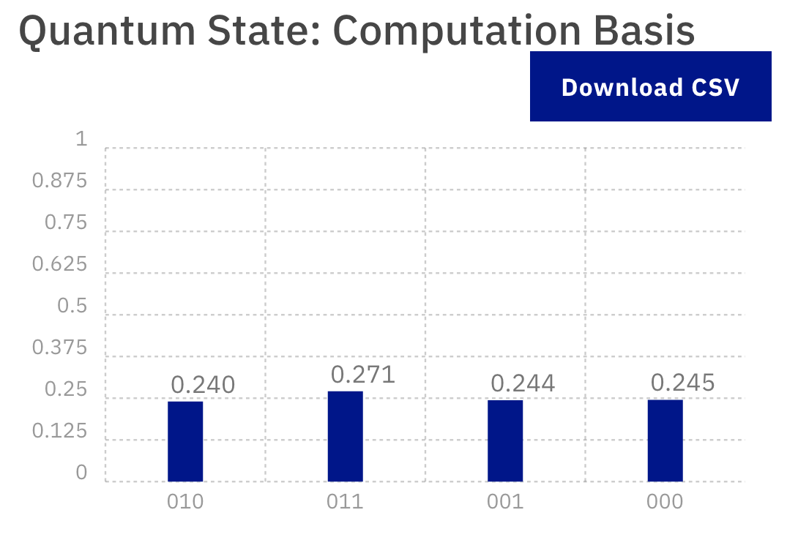

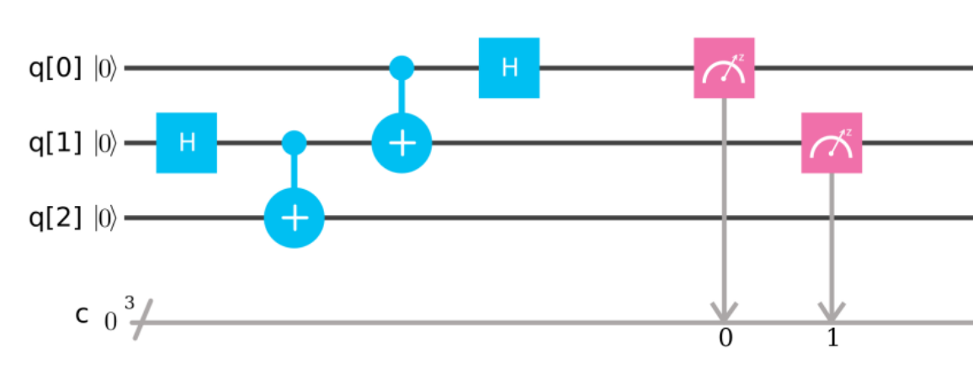
3 qubit circuit with Bell measurement
(Alice’s State to be teleported)
Notes:
=\frac{1}{2}[&\ket{00}(\alpha\ket{0} + \beta\ket{1}) + \ket{10}(\alpha\ket{0} - \beta\ket{1})\\ + &\ket{01}(\alpha\ket{1} + \beta\ket{0})+ \ket{11}(\alpha\ket{1} - \beta\ket{0})]

Slide 14
10min: Implement Controlled Z (sign flip of target bit if control bit is on ‘1’)

Slide 15

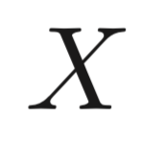

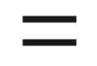
Controlled Z Gate
Tipp: Use

Slide 16
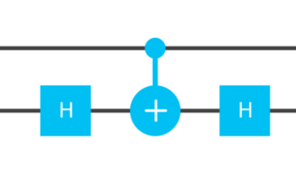
Controlled Z Gate
Tipp: Use

Slide 17
25min: Combine all to teleport qubit from ‘Alice’ to ‘Bob’ Teleport following states:
a)
b)
c)

Slide 18
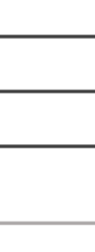
3 qubit circuit for Quantum Teleportation
?

Slide 19
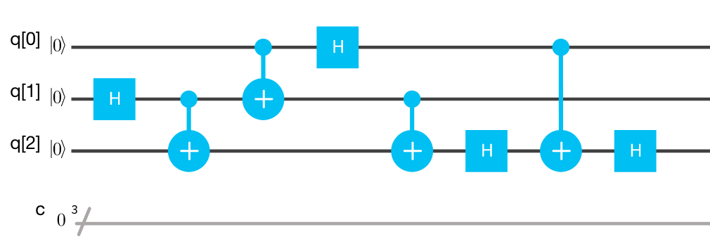
3 qubit circuit for Quantum Teleportation

Slide 20
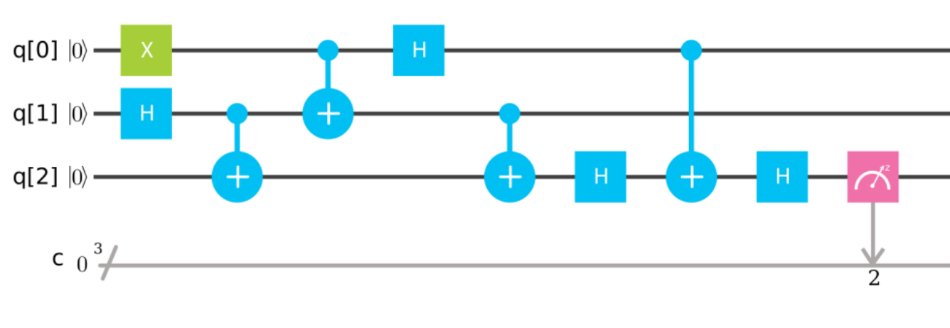
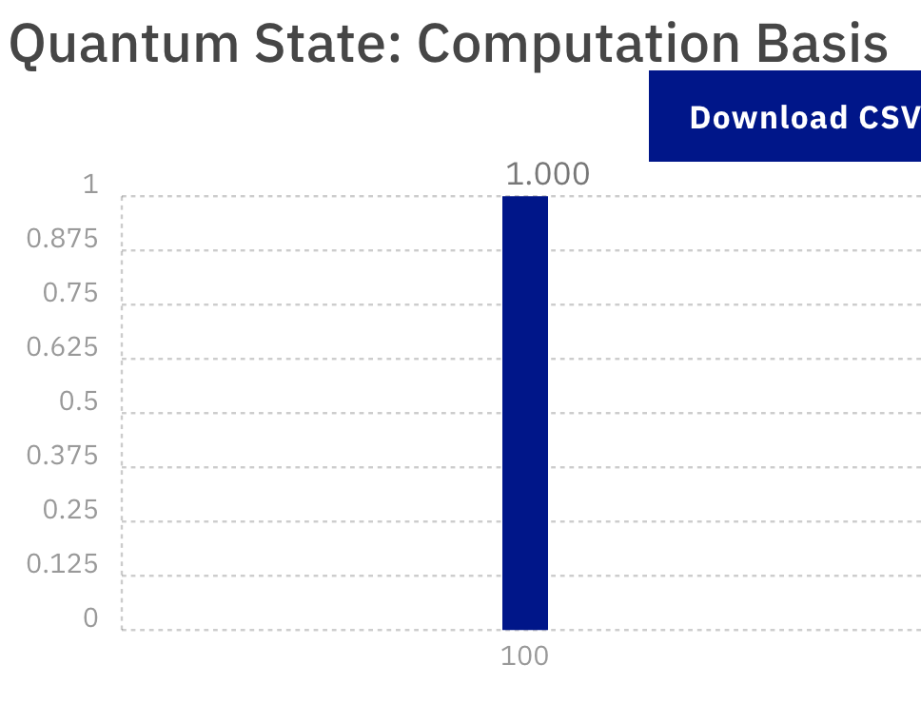

3 qubit circuit for Quantum Teleportation:

Slide 21
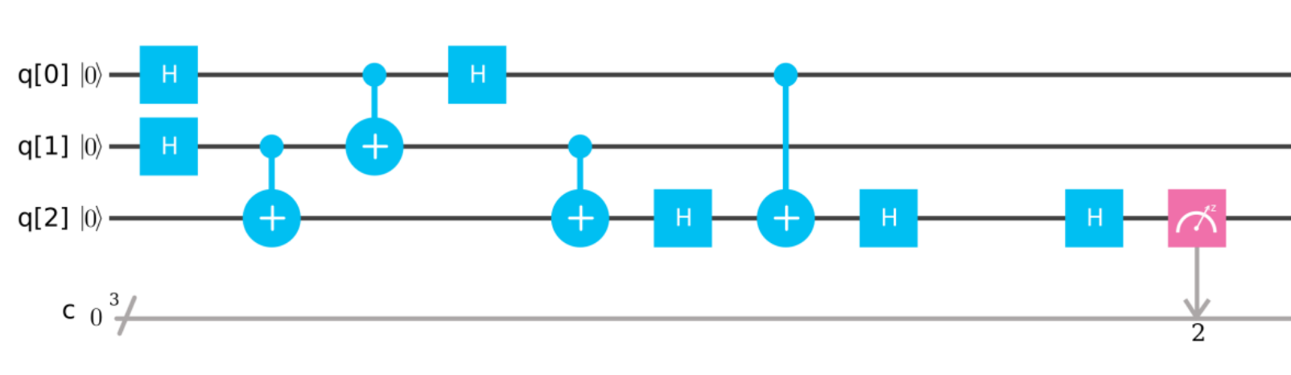
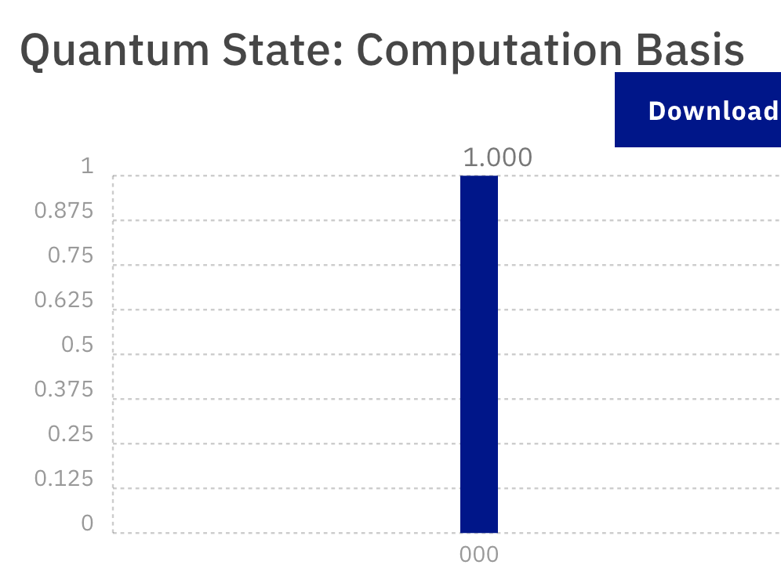

3 qubit circuit for Quantum Teleportation:
Undo Hadamard

Slide 22
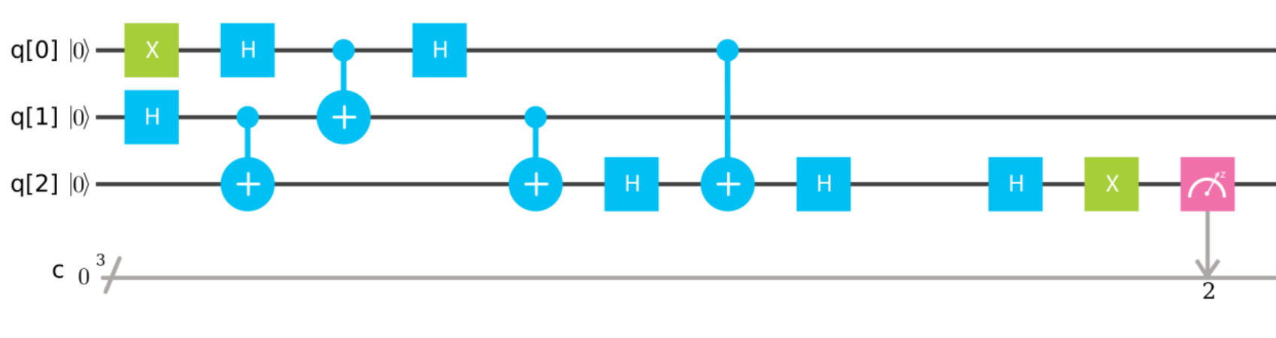


3 qubit circuit for Quantum Teleportation:
Undo H & X

Slide 23
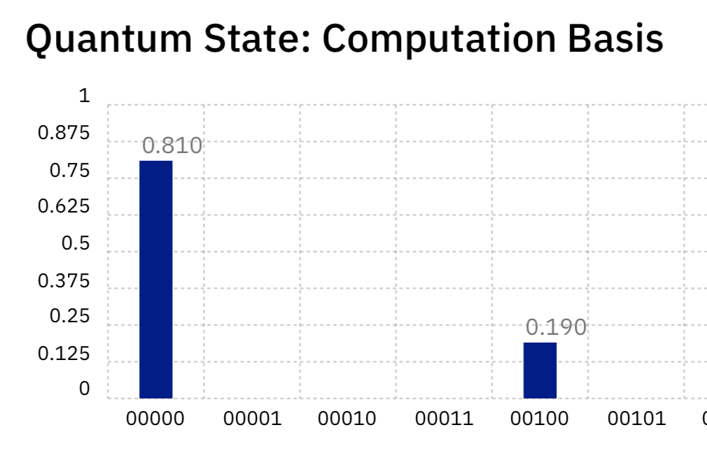
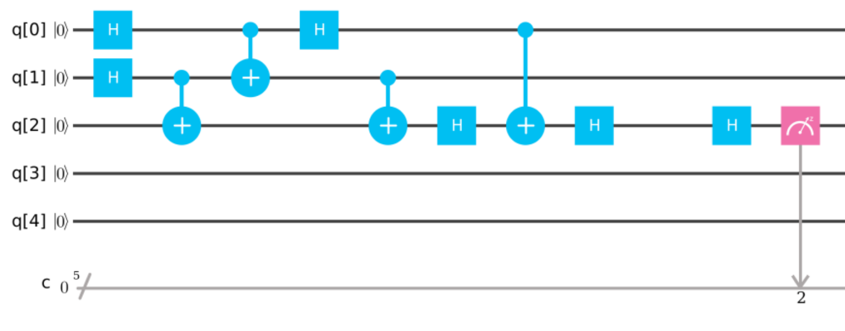
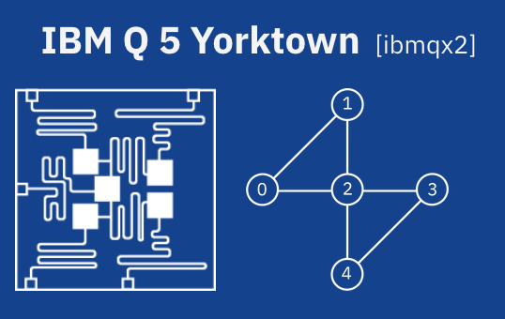
Real 5-Qubit Quantum Computer
Teleport:
(1024 shots)
Undo Hadamard

Slide 24
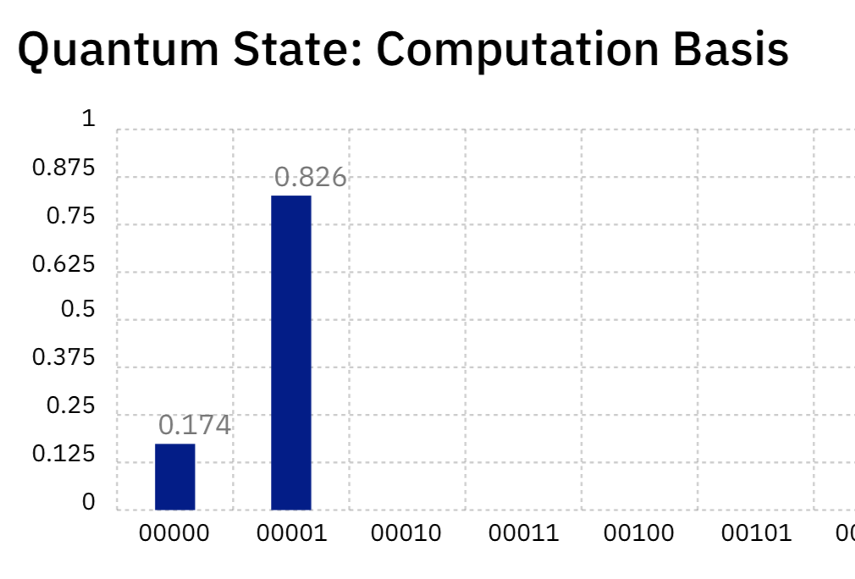
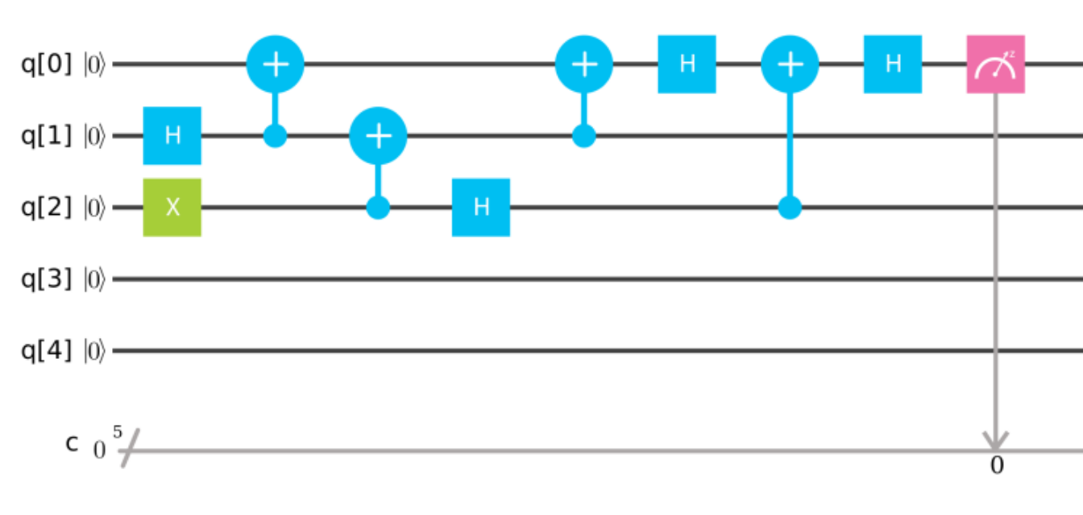
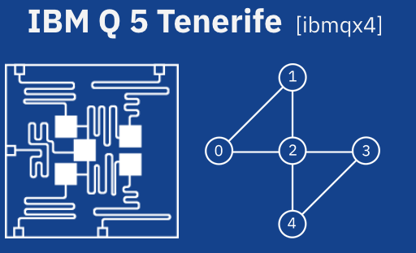
Real 5-Qubit Quantum Computer
Teleport:
(1024 shots)

